Slide 1

Project Apollo
An open source oxygen concentrator
http://project-apollo.org
#project-oxygen-concentrator

Slide 2


Project Apollo
Why
O2 needed for ventilators, oxygen therapy
Typical FiO2 0.3 … 0.5, up to 1
Oxygen generation is a big problem in developing countries
No established infrastructure
Oxygen bottles are expensive
People are already looking at alternative (local) ways for producing and delivering oxygen
https://www.economist.com/graphic-detail/2021/03/09/hospitals-are-running-out-of-oxygen-to-treat-covid-19-patients
https://www.cidrap.umn.edu/news-perspective/2021/03/who-sounds-alarm-over-covid-linked-oxygen-crisis
https://apnews.com/article/oxygen-crisis-africa-latin-america-eb0d2731a8613c1ae218db7d32a227a6

Slide 3

Project Apollo
What is it
Goal = enabling people around the world to build the prototype ASAP
Focus = Simplicity and speed of build
Simple, reliable design (zeolite-based PSA system)
Flexible, open source, off-the-shelf materials
Very low cost (aspirational target = $200 for 15 liters/min @ 80%)
Final goal = Enable people to iterate and publish their own designs in the community

Slide 4
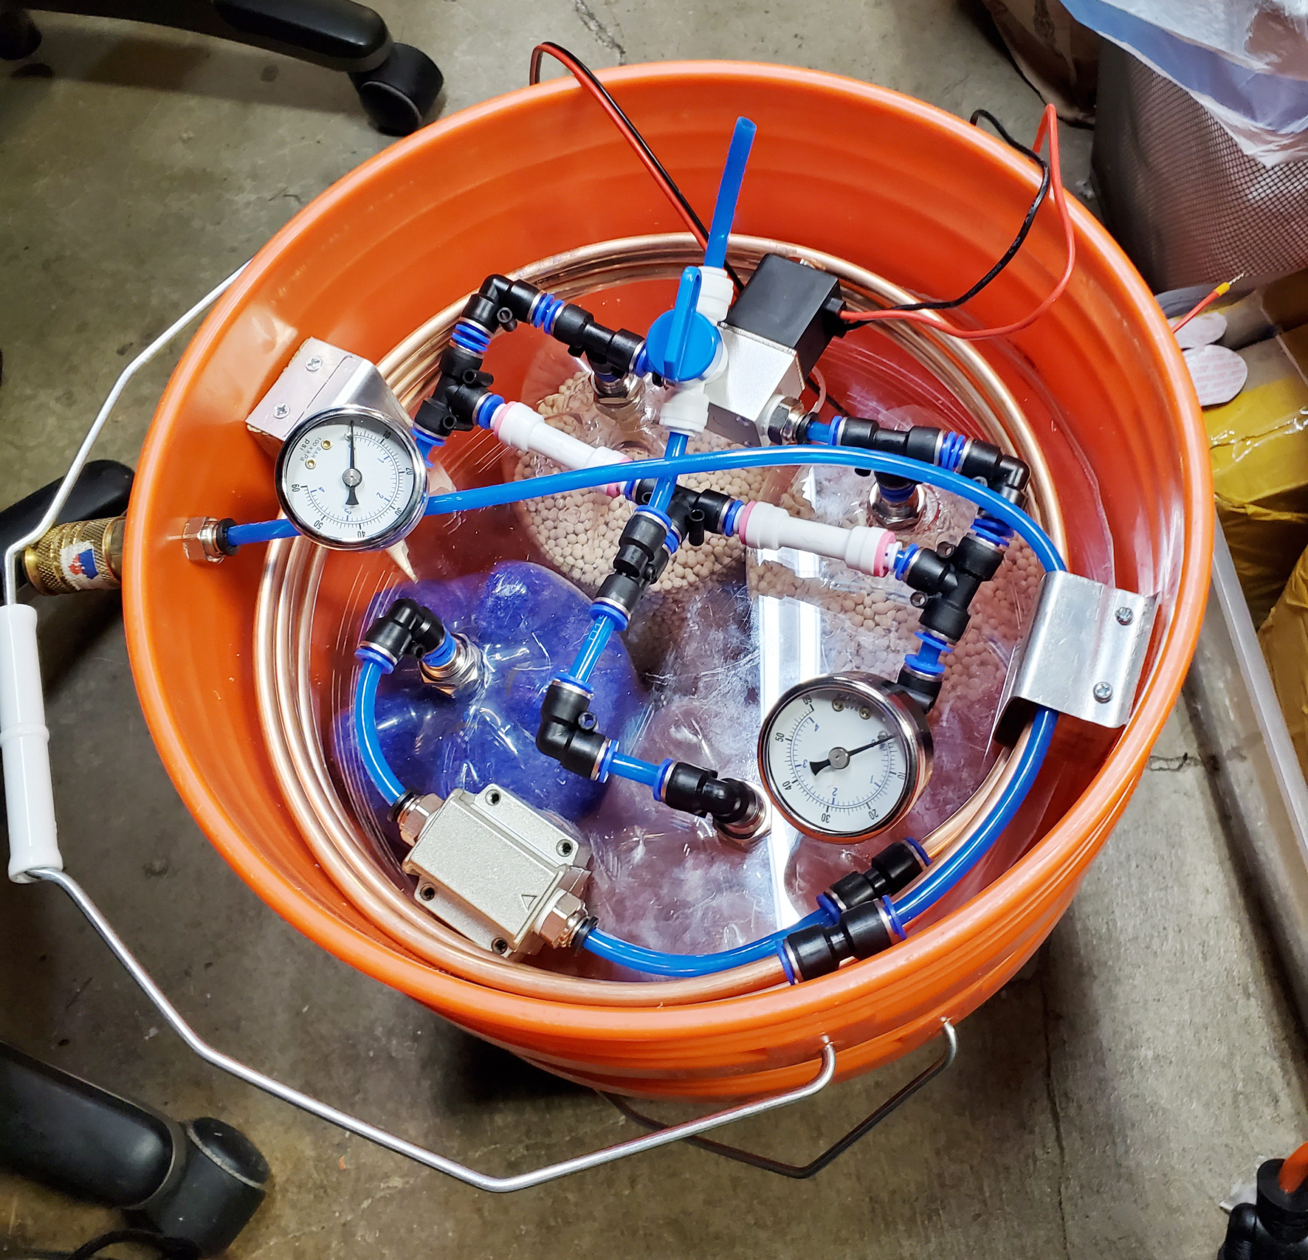
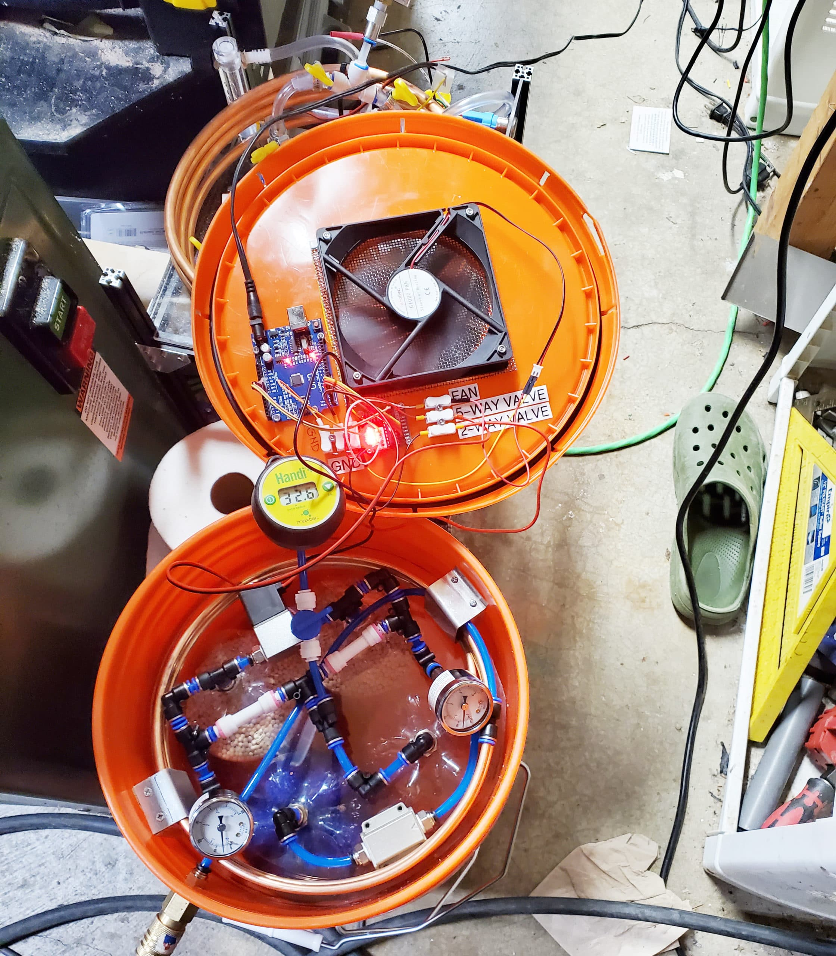
Project Apollo v2
How to build it
Follow the published build documentation
Buy/source the materials (check out the BOM)
Build the prototype
Validate O2 concentration and flow. Use a good reference O2 and flow sensor for calibration
Multiple iterations/variants have been built
O2 concentration 45 … 70%, 5 lpm

Slide 5

Project Apollo v4
Apollo v4
Focus = medical device
Safety: detect all failure scenarios
Ease of use: User experience and maintainability. Clear, actionable error messages
Self-regulating: Patient sensor/data feedback loop
Control box
Touch screen for diagnostic messages, medical-grade buzzer
Open source, modular PCB design. Works with a variety of sensors
Self-tuning: valve timing, auto-adjusts to changes in compressed air input pressure, machine learning
Integration with SpO2 oximeter Bluetooth sensor
Cloud data integration for patient monitoring
Self-contained enclosure
Built-in compressor
Full focus on thermals, airflow, noise reduction
Collaborations
Funding: Quick2space.org
Volunteers: Helpful Engineering, Microsoft Garage, Public Invention
Documentation, code
http://project-apollo.org

Slide 6
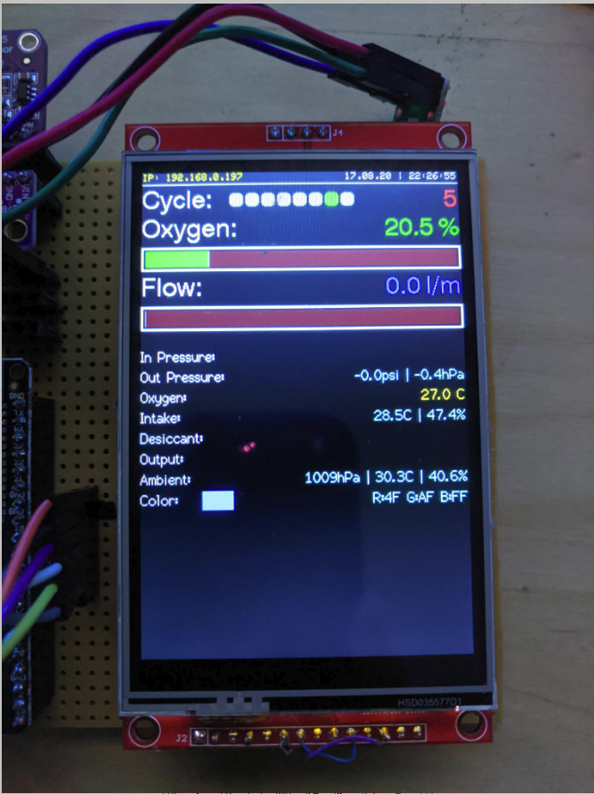
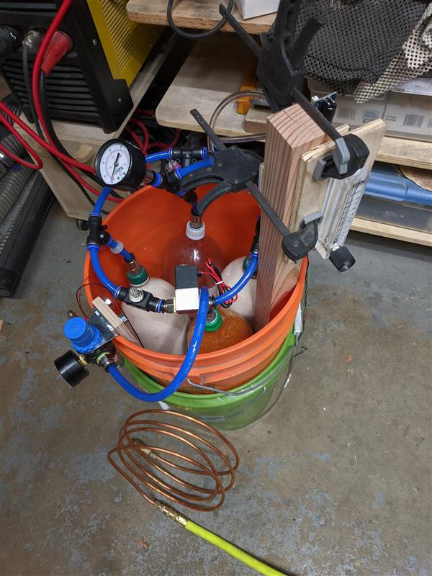
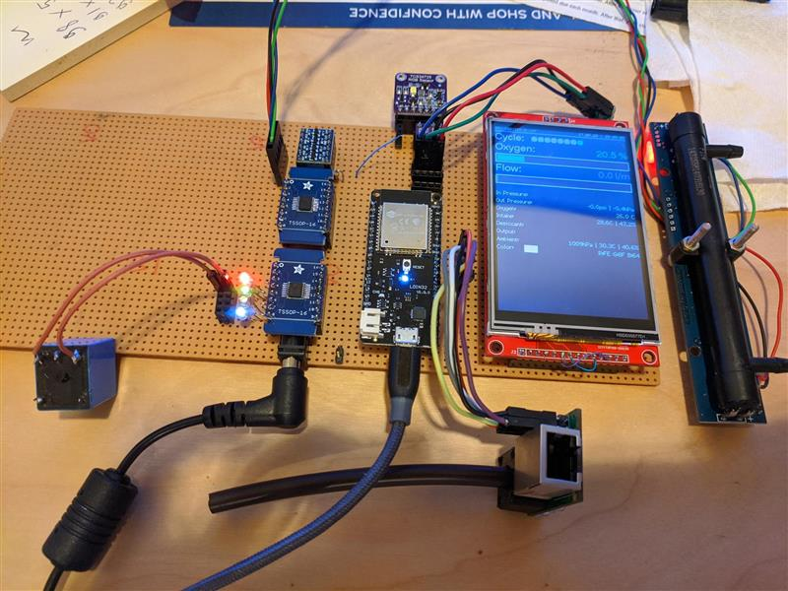
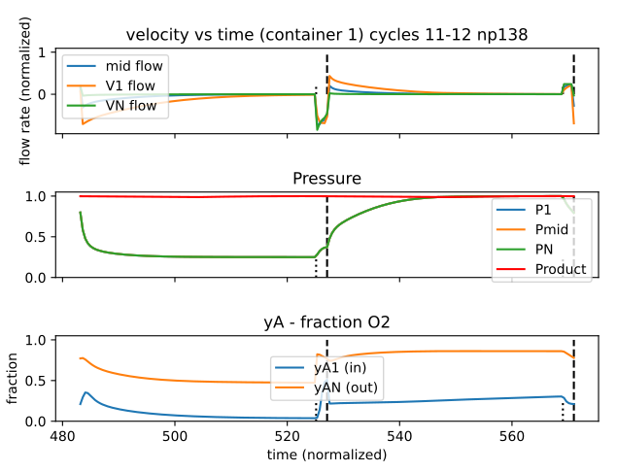
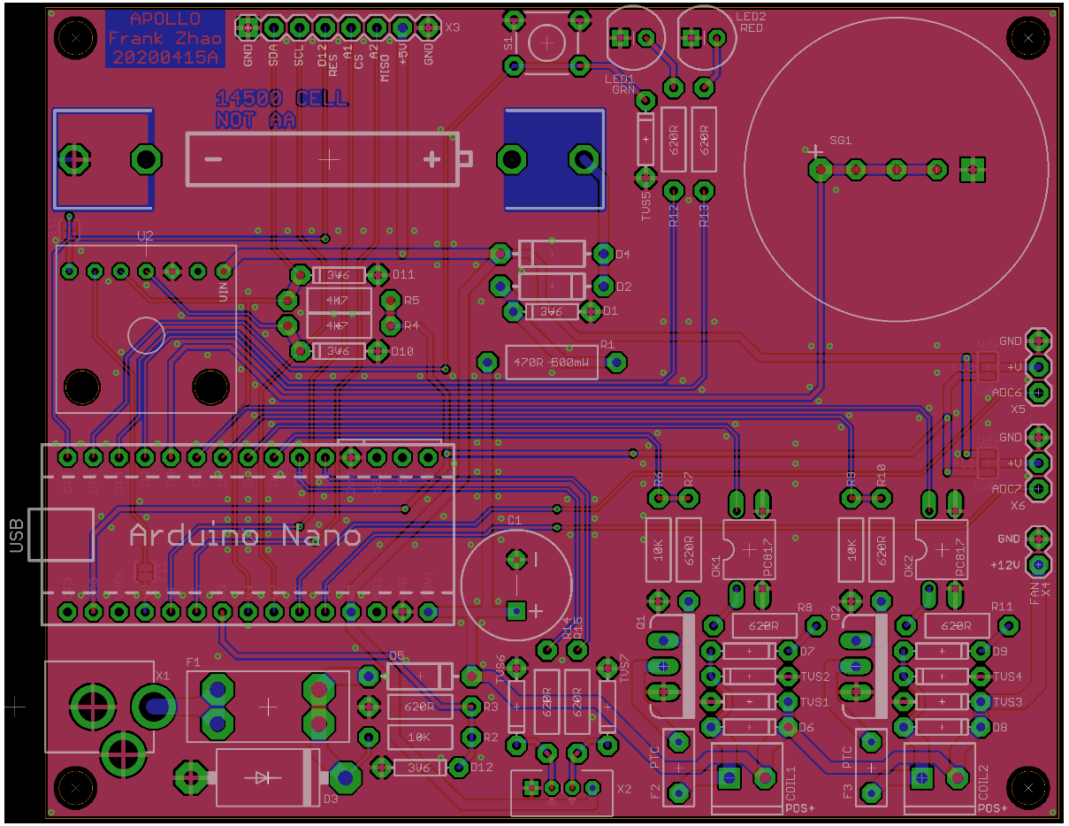
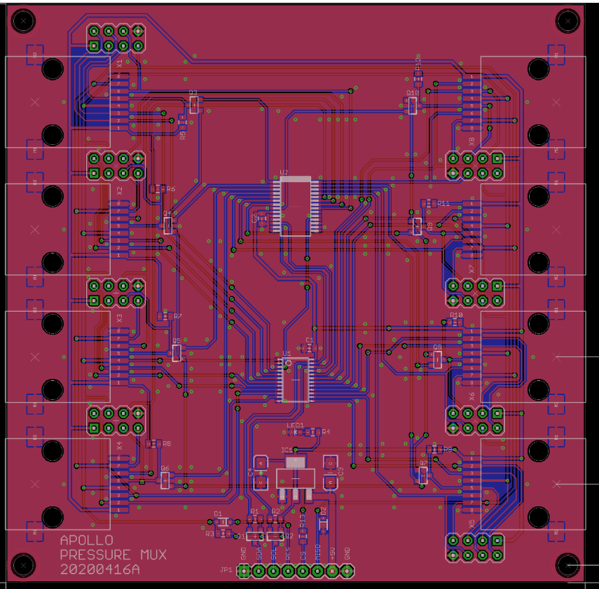
Project Apollo v4
http://project-apollo.org

Slide 7
Thank you!

